Slide 1

NEUCENT TECHNOLOGIES PRIVATE LIMITED

Slide 2
ABOUT NEUCENT TECHNOLOGIES : Established in 2023 Neucent Technologies Pvt. Ltd. Leading Provider of Mobile and Web Development Solutions Specializing in Native & Cross-Platform Technologies, AWS, Blockchain, AI/ML, and IoT Innovation.

Slide 5
OUR PRODUCTS:

Slide 6
Industries We Serve Norex Flavours Private Limited is well known company engaged in producing and exporting a wide product line including fragrance & flavor products. These products are processed at our state-of-art processing unit, which is equipped with advanced technological equipment & tools. Our high quality products find extensive applications in different industries.

Slide 7
The major industries we serve with our high quality service range are:

Slide 8
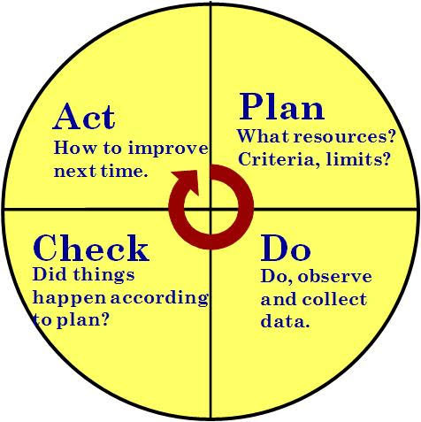

Simple Ways to Reach out to Your Customers
Know your audience
Provide consistent customer experience
Invest in Content Marketing
Take advantage of customers’ testimonials
Set up a referral program
Stay connected via newsletter
Listen to your customers’ feedback
Demonstrate your products or services

Slide 9
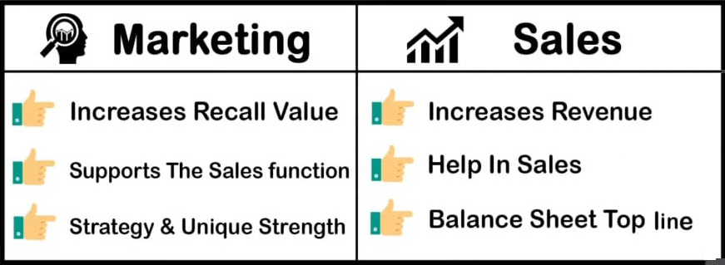
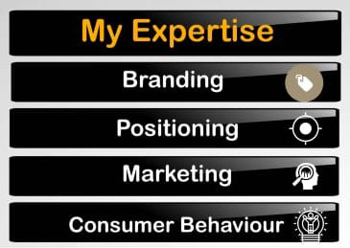
Types of marketing
Niche Marketing
Trade Show Marketing
Social Media Marketing
Freebie Marketing
Under Cover Marketing
Outbond Marketing & Inbond Marketing
Cross Promotion

Slide 10


Outbond Marketing & Inbond Marketing

Slide 11
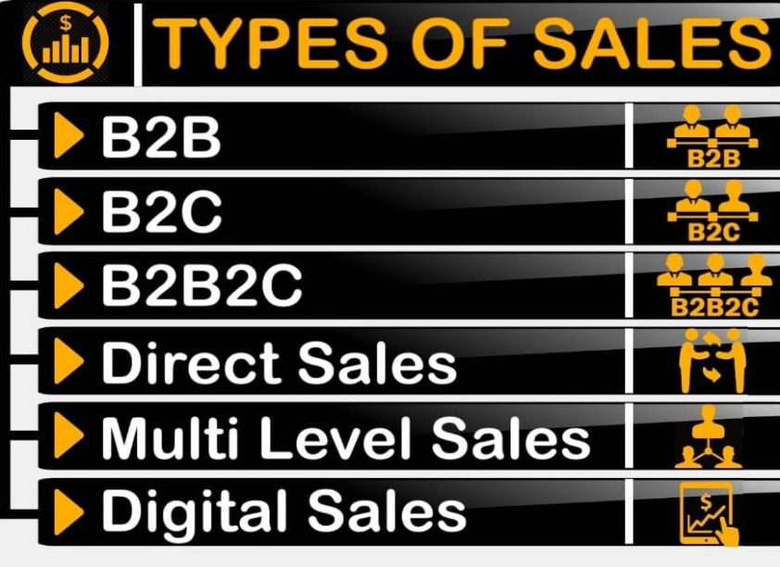
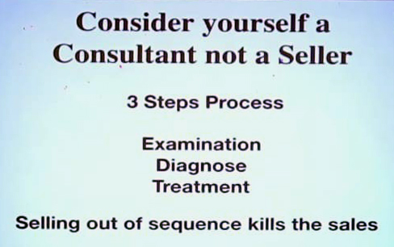
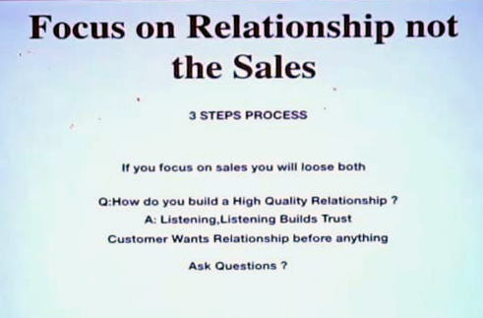
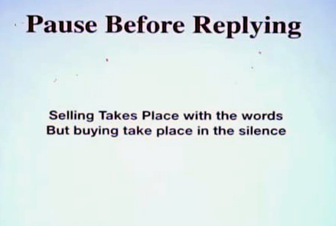
Sales
How to sale a Product ?
3 Step formula

Slide 12
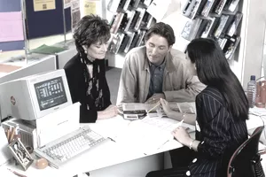
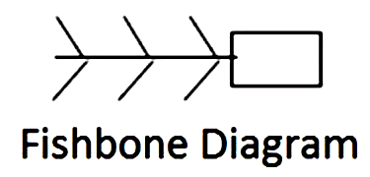
HOW TO GET CLIENTS
Find clients through your workplace.
Find clients through business organizations.
Tell friends and family you'd like more clients.
Advertise for clients.
Get clients through your personal activities.
Get clients through referrals.
Get clients through social media.

Slide 13


Online Lead Generation Techniques that Work 1. search Engine Optimization. 2. Pay Per Click Advertising. 3.Lead Generating Website. 4.Online Networking. 5.Webinars. 6.Industry Research Reports. 7.Online Marketing Videos.

Slide 14


If you want to boost sales…. Focus on the existing customers. Learn about competitors. Innovation and unique products. Cultivate value. Build a customer service approach. Customer relations. Promotion. Marketing. BANT

Slide 15

Your e-marketplace for Flavours, Fragrances & Essential Oils.
Taking our legacy of Flavours and fragrances forward, we have used our competencies to make our range readily available to everyone from MNC's to every home in India. Whether you are an application laboratory trying to work out the best Flavours combination for your products, or a home-baker churning our exceptional cakes Norexmart is here for you.
Our inhouse expertise has an impressive background in flavour & fragrance technology and are therefore adept at creating products that surpass industry standards.

Slide 16
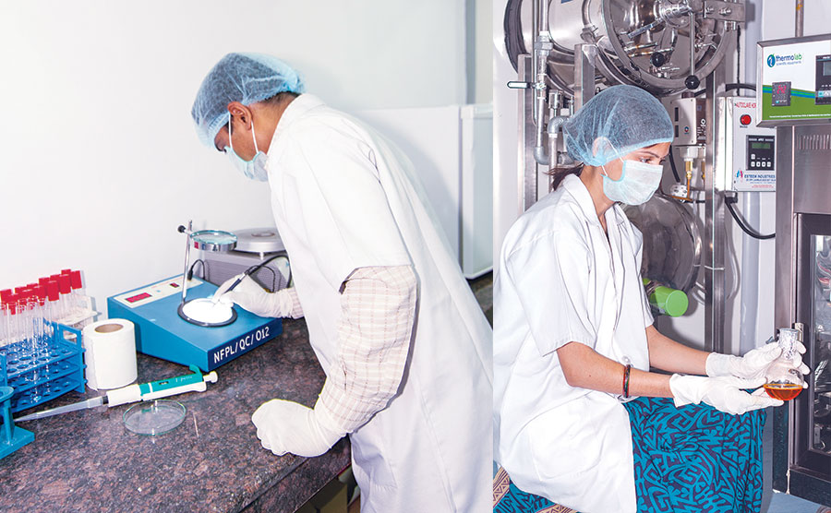
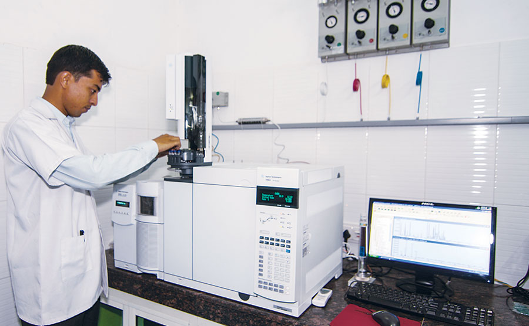
QUALITY CONTROL We are highly prudent about offering the finest grade of essential oils & aroma chemicals to suffice the needs of our clients. We have a team of quality control and quality assurance system and management system to monitor all facets of the business. Our QC team testify our product line on various quality parameters ensuring best quality product delivery to our highly precious patrons. Apart from advanced equipment, our infrastructural premise is also accomplished with laboratory facilities for our regular analytical works, and research as well.

Slide 17



CERTIFICATIONS
Be Assure
With the assistance of our well equipped infrastructural unit and quality management system, we have earned certifications from different organizations at international level.

Slide 18
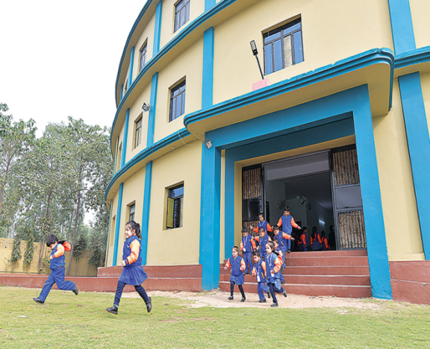
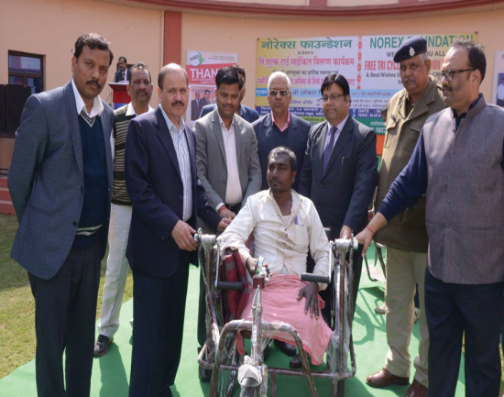

Corporate Social Responsibility
beyond Business...
At Norex, we believe that as organizations grow in size and scale, they must play an active role in public welfare. Their accountability must go beyond business interests. Towards society at large and in transforming communities they operate in. So, from the very beginning, we have endeavored to make a positive contribution to the underprivileged communities by supporting a wide range of socio-economic, educational and environment initiatives.
Norex CSR programs focus on creating sustainable development and livelihood for local communities.
Our CSR agenda rests broadly on two pillars – education and environment initiative and farmers welfare.
Various initiatives have been undertaken within the broad frame of Environment and Climate Change to address the conservation of natural resources and energy, minimize waste generation, enhance recovery and recycling of material and develop eco-friendly process and systems.
Norex has been certified ISO 14001:2004 for this.
Education
Health Care
Farmers Welfare

